Slide 1
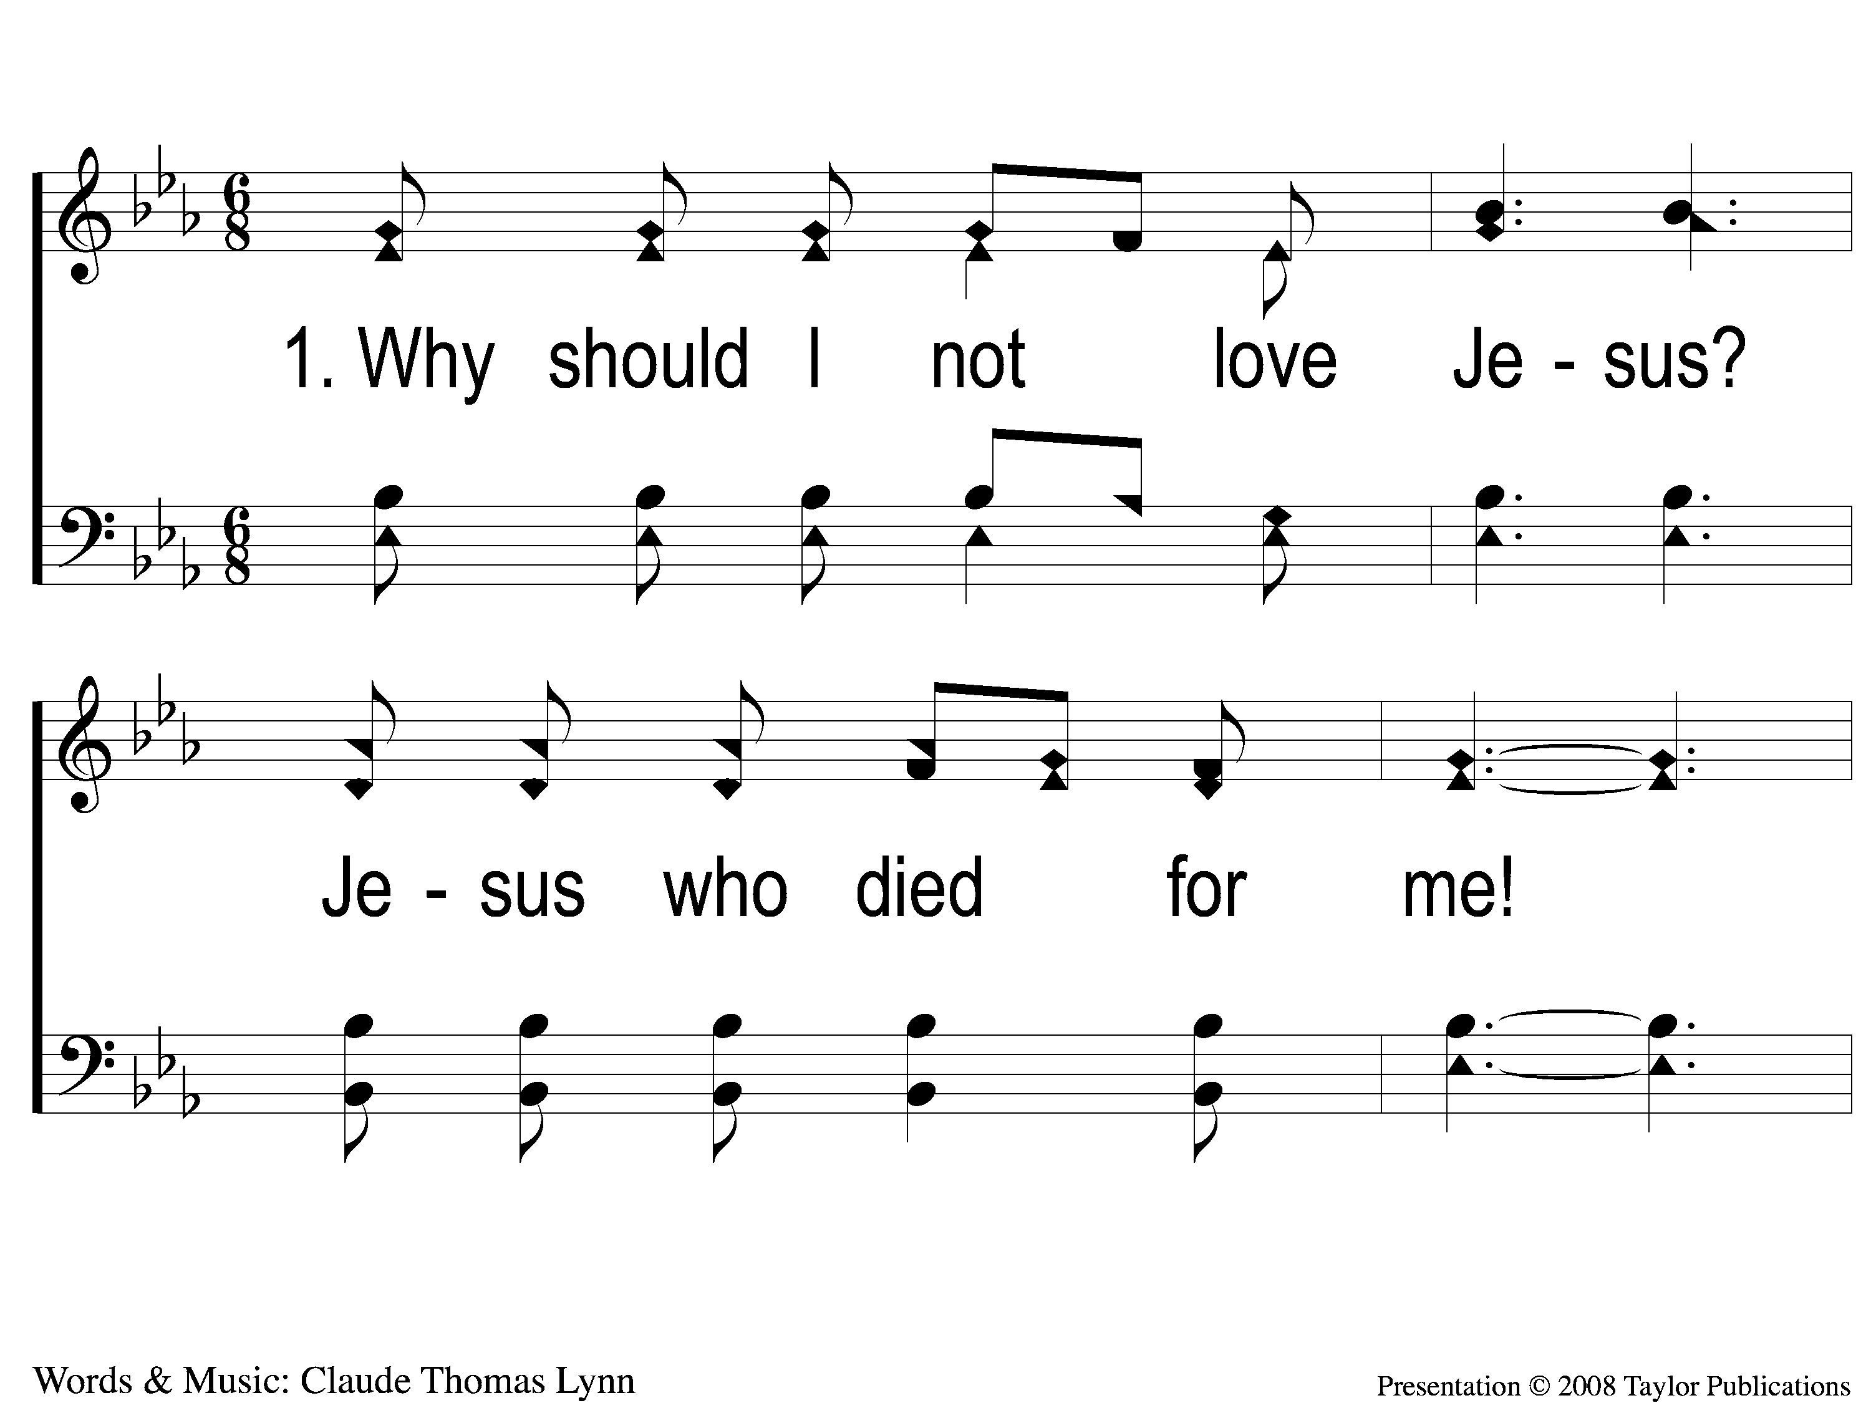
1-1 Hero of Calvary
Hero of Calvary
93

Slide 2
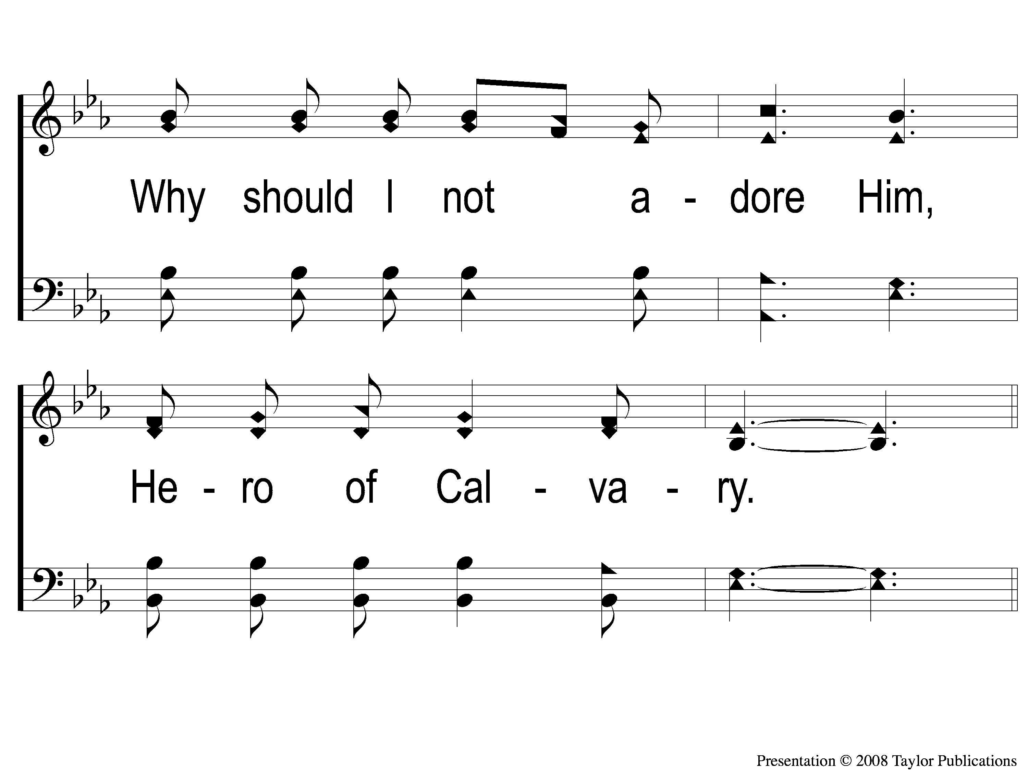
1-2 Hero of Calvary
Hero of Calvary
93

Slide 3
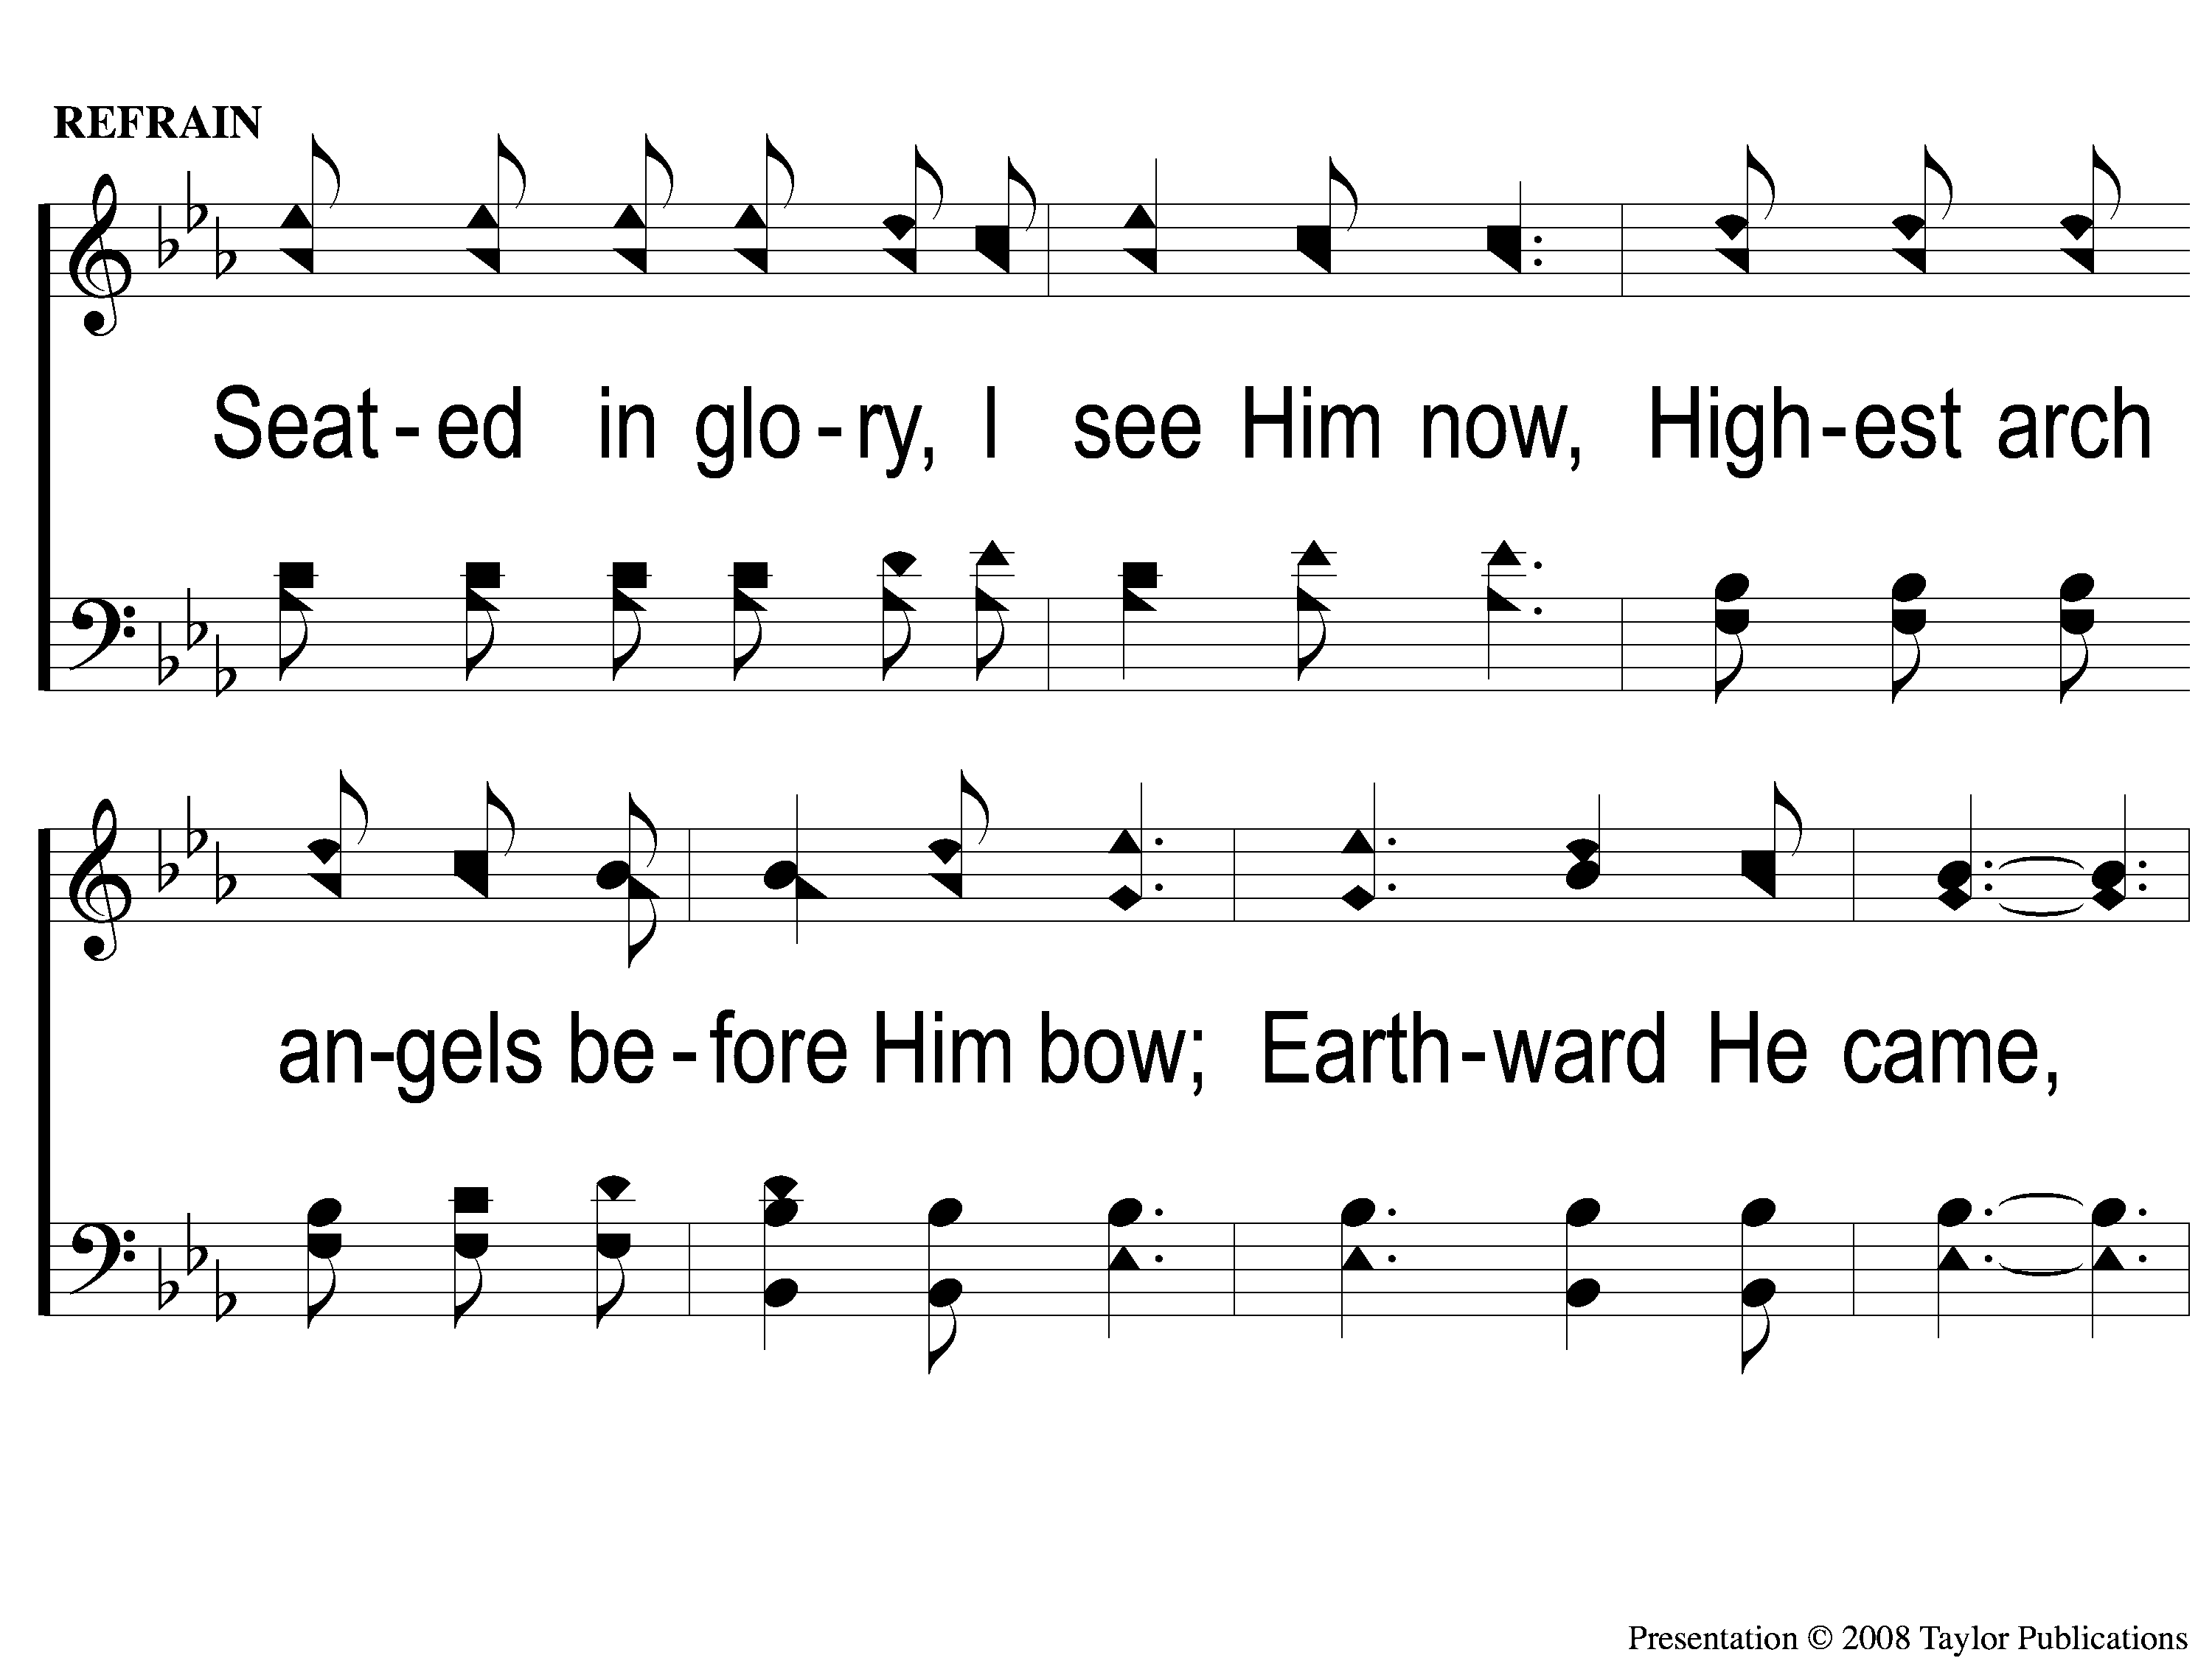
C-1 Hero of Calvary
Hero of Calvary
93

Slide 4
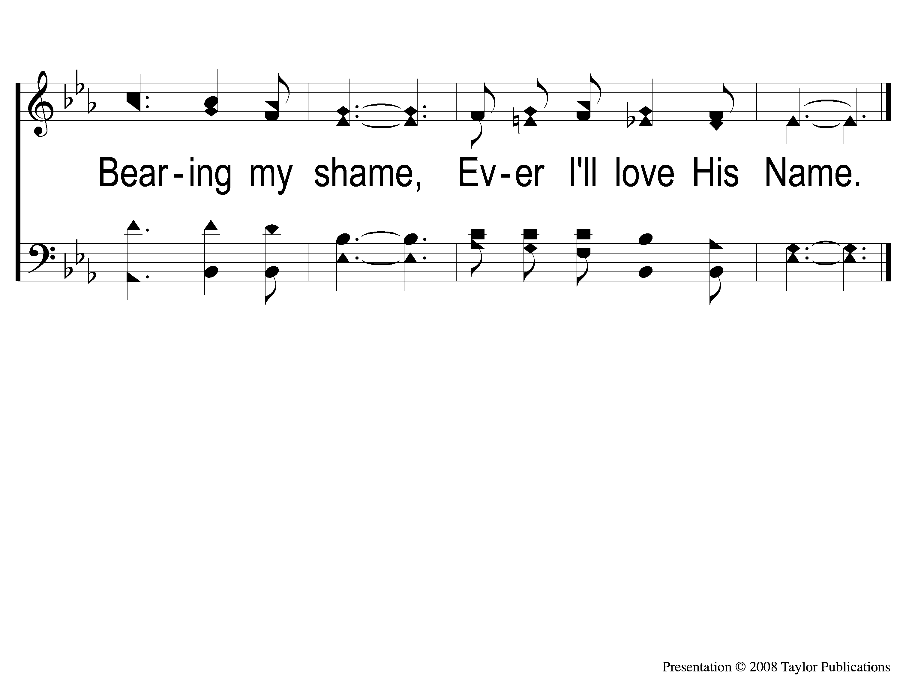
C-2 Hero of Calvary
Hero of Calvary
93

Slide 5
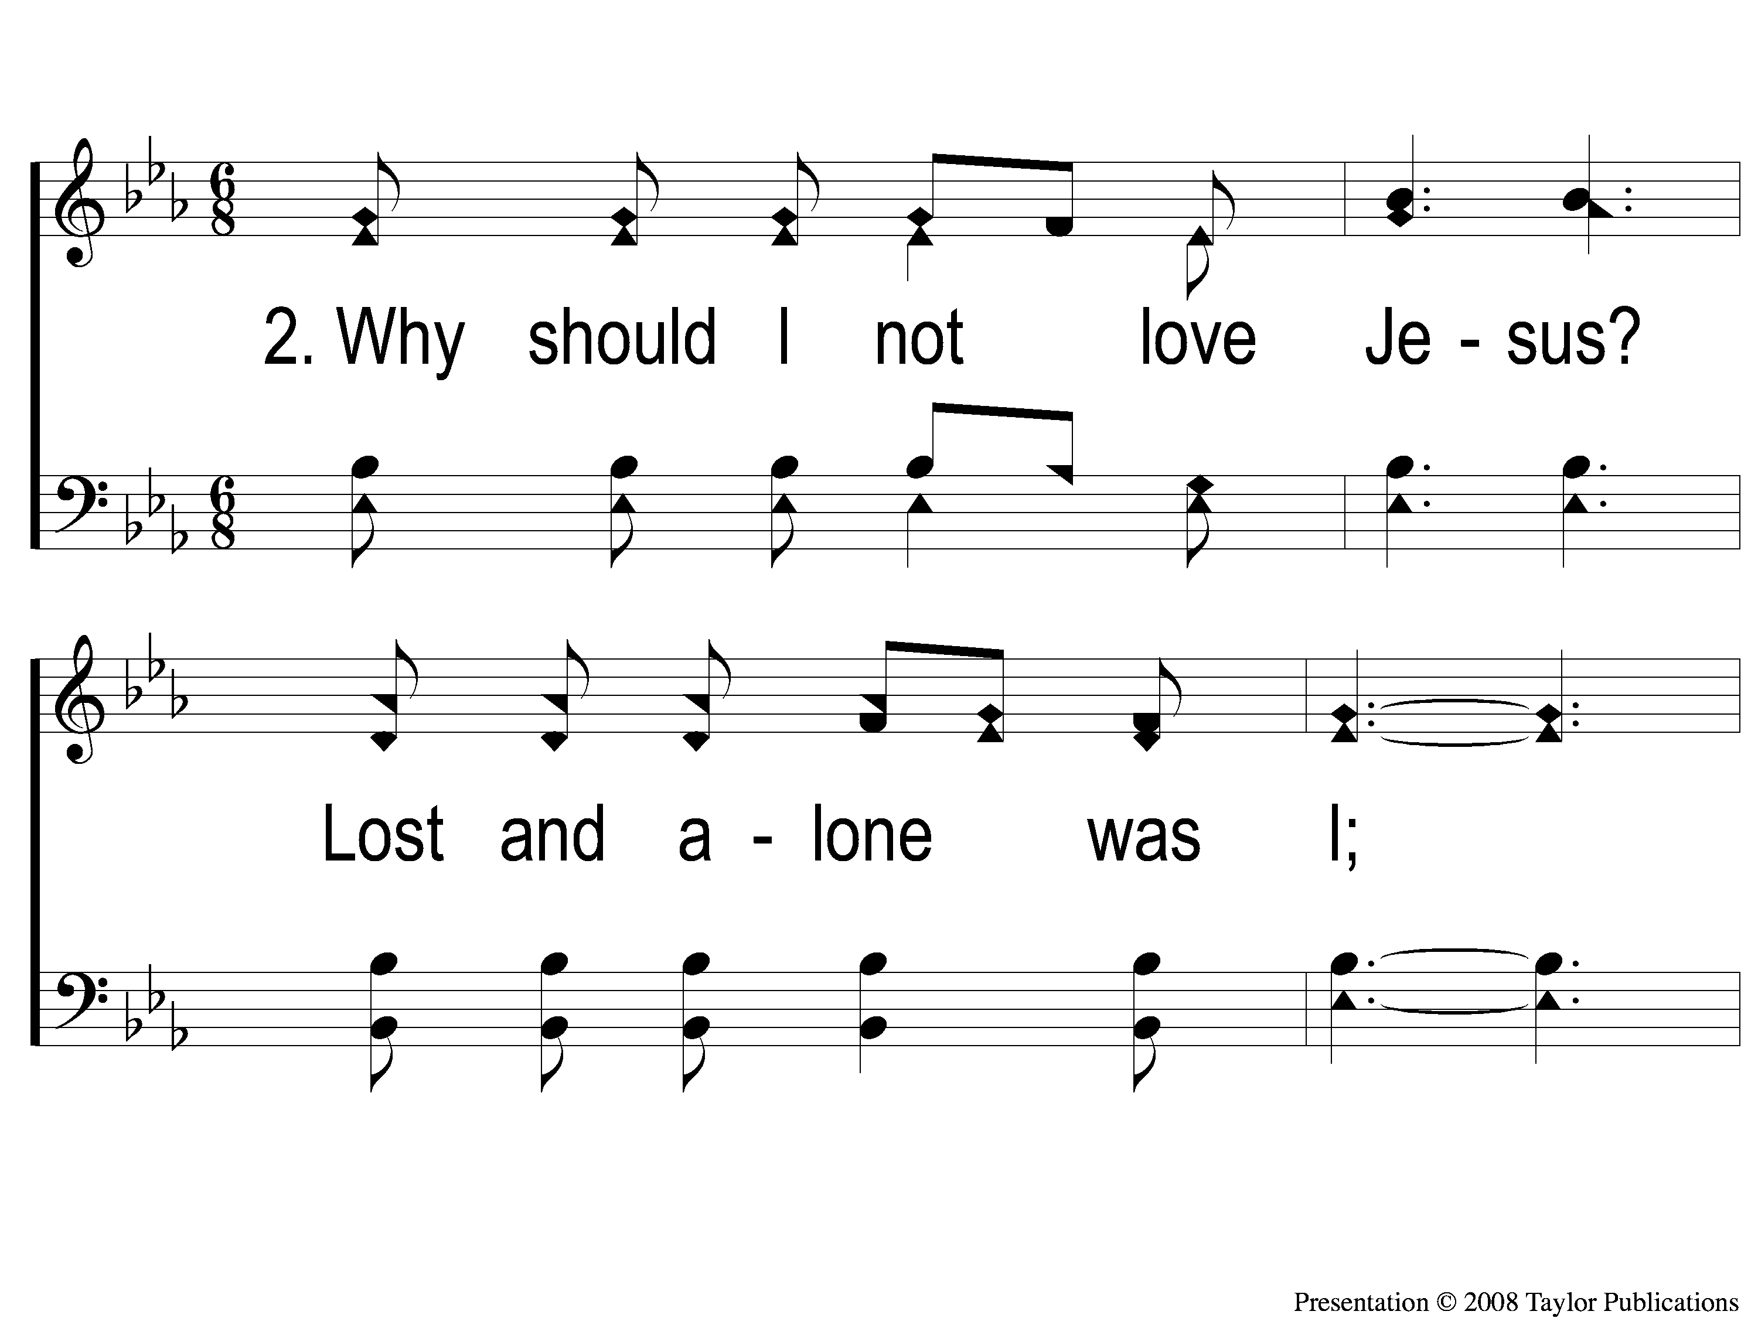
2-1 Hero of Calvary
Hero of Calvary
93

Slide 6
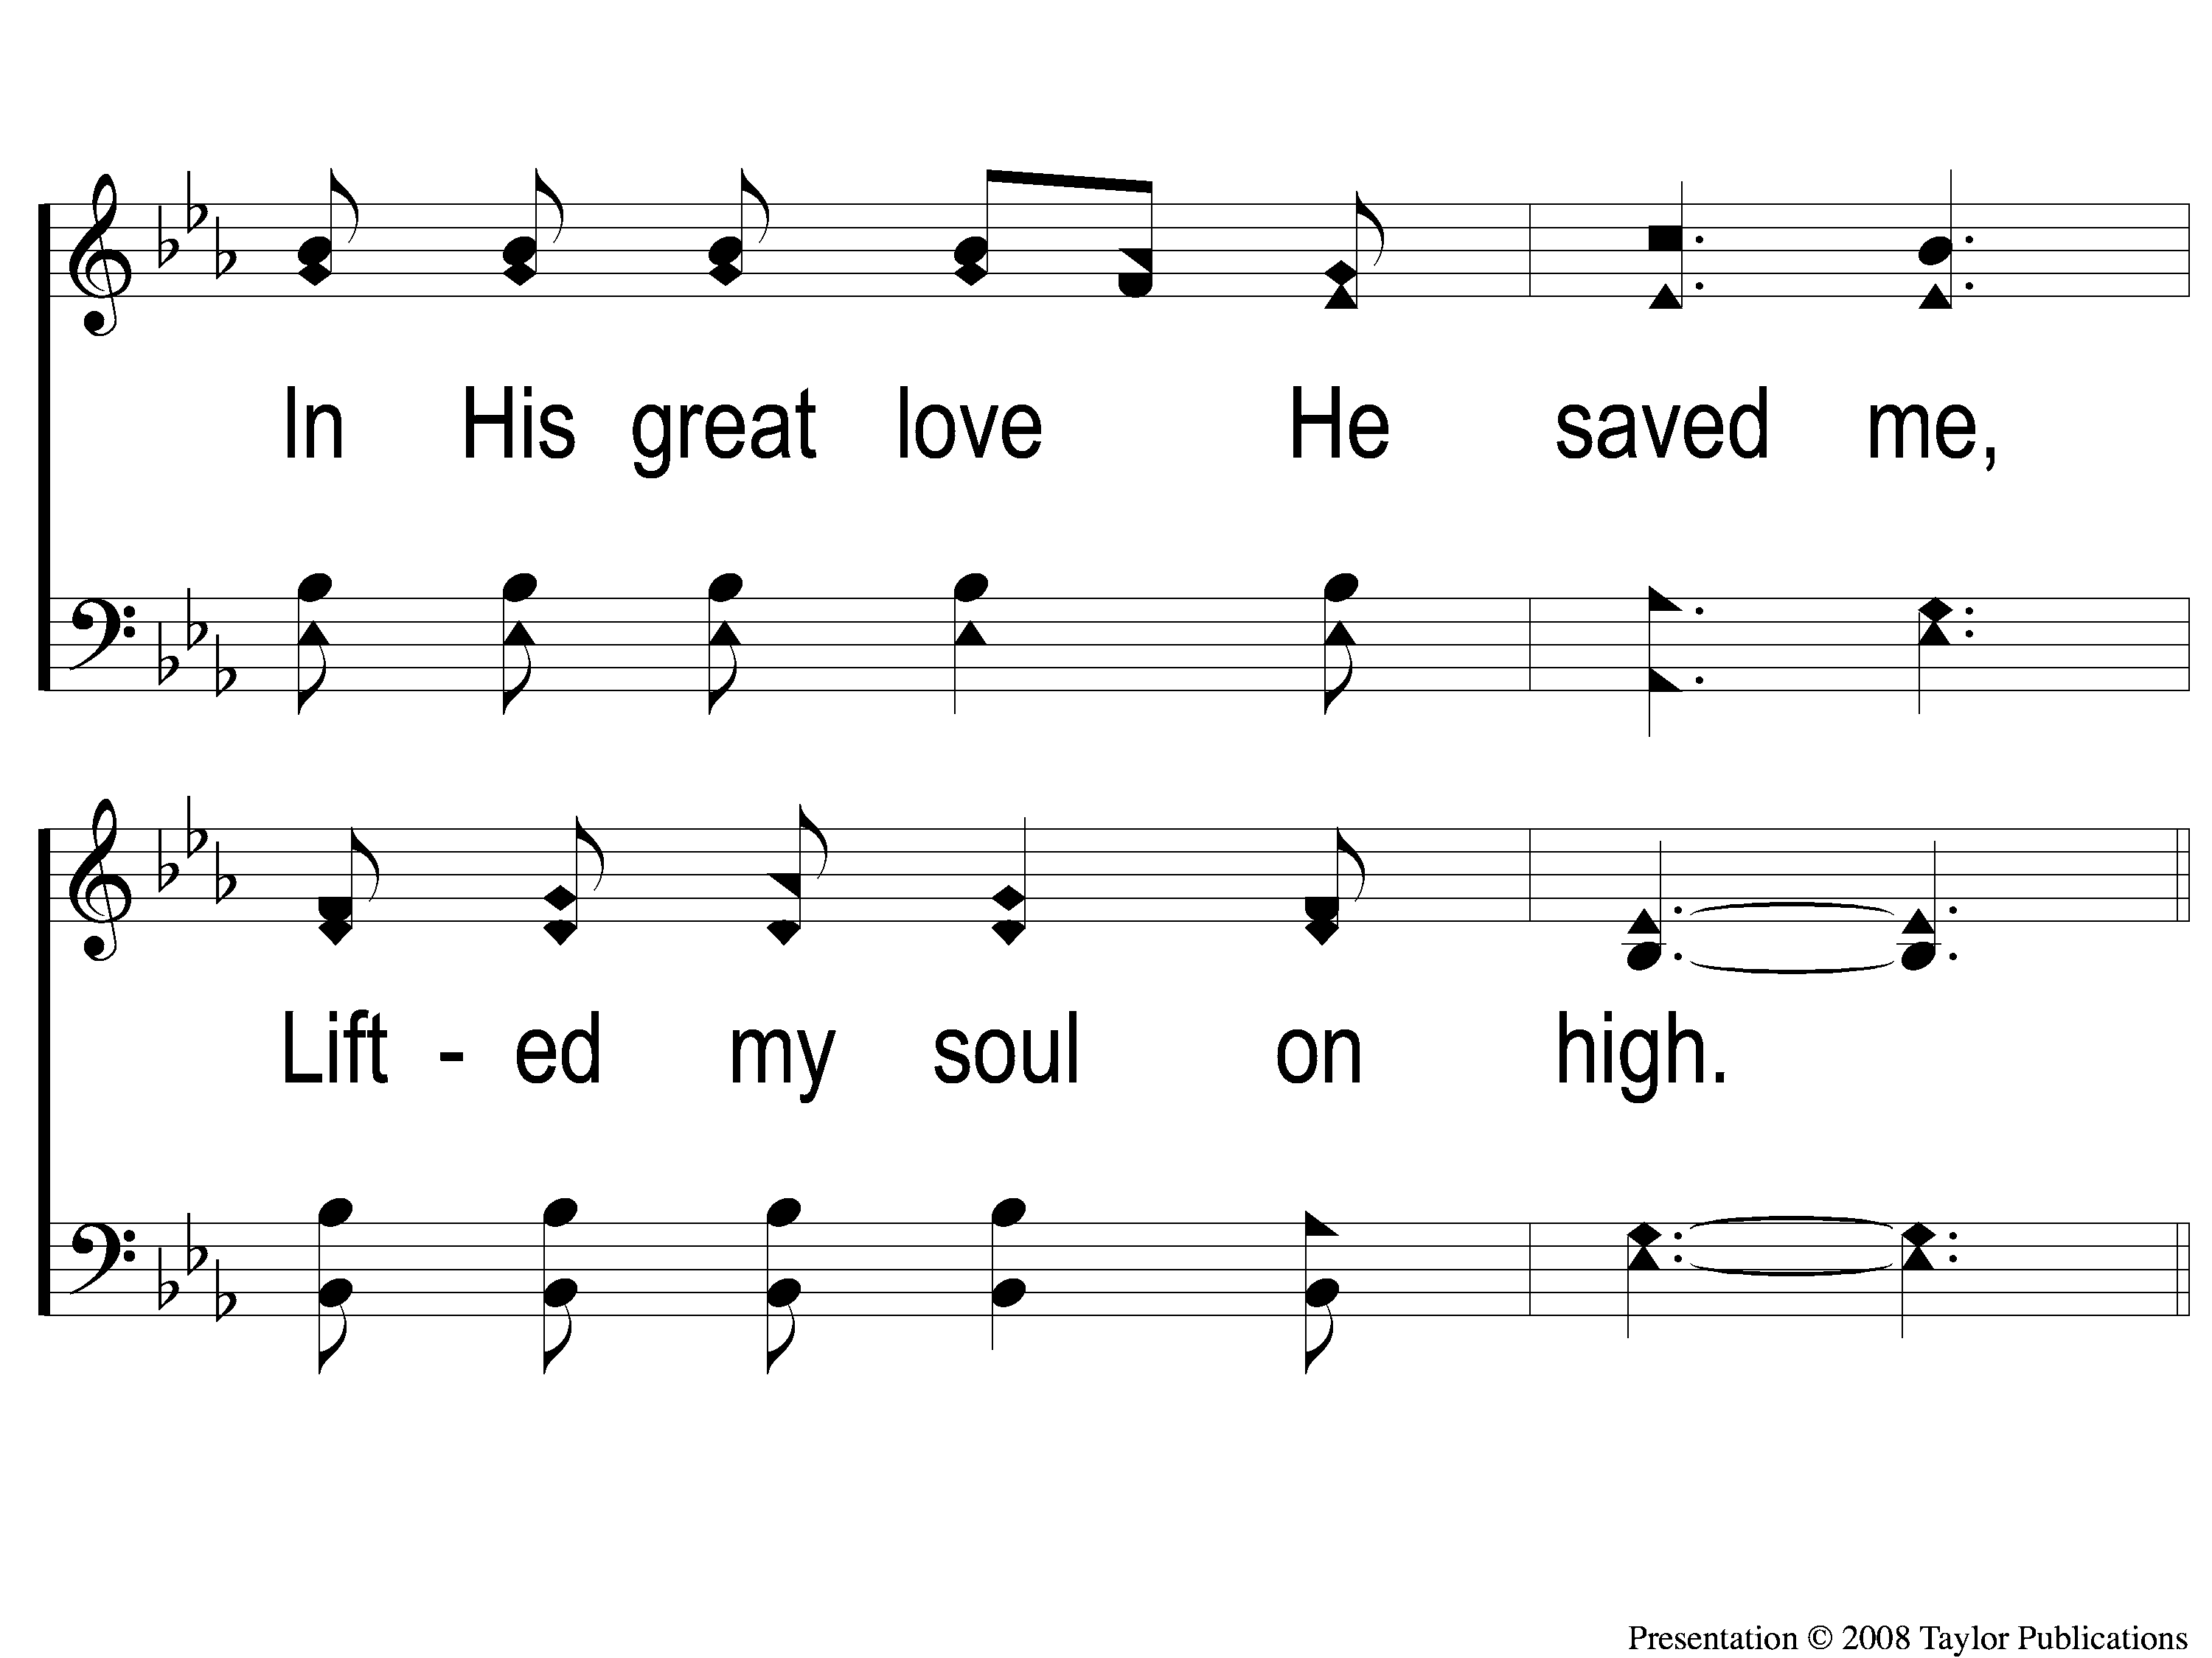
2-2 Hero of Calvary
Hero of Calvary
93

Slide 7
C-1 Hero of Calvary
Hero of Calvary
93

Slide 8
C-2 Hero of Calvary
Hero of Calvary
93

Slide 9
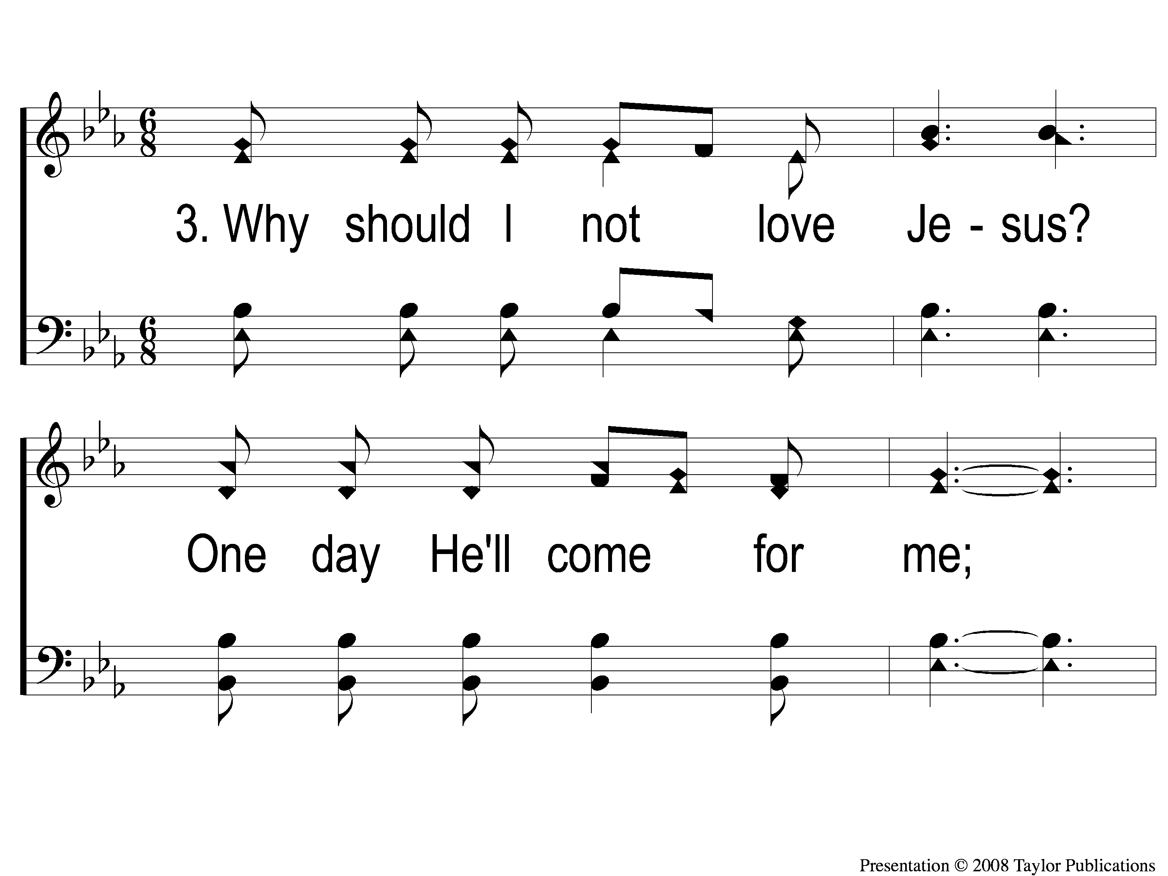
3-1 Hero of Calvary
Hero of Calvary
93

Slide 10
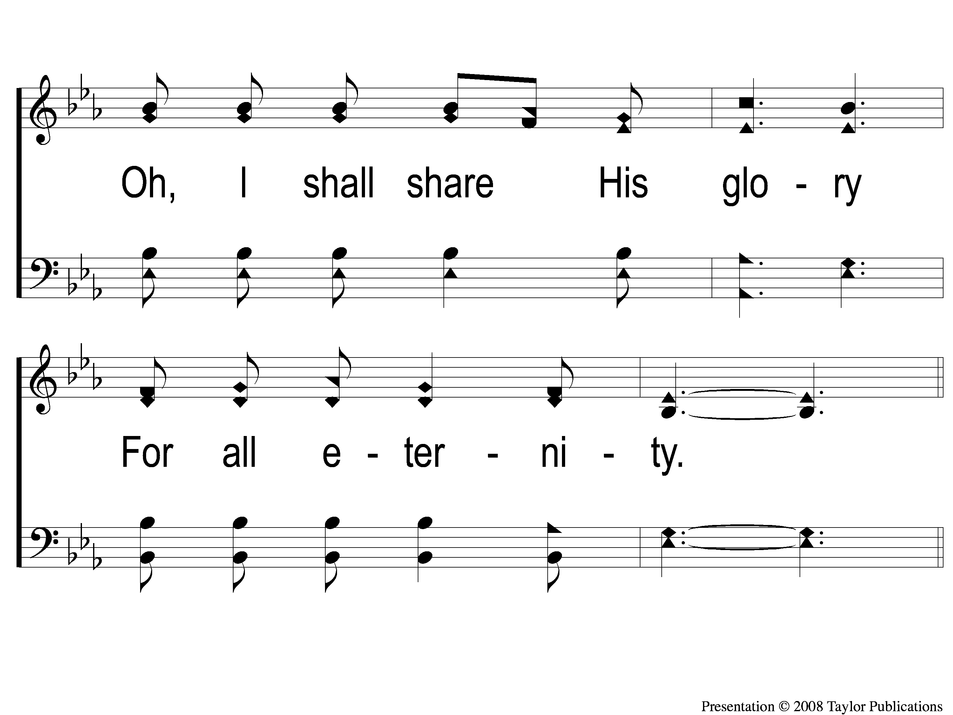
3-2 Hero of Calvary
Hero of Calvary
93

Slide 11
C-1 Hero of Calvary
Hero of Calvary
93

Slide 12
C-2 Hero of Calvary
Hero of Calvary
93

